Slide 1
Viewpoint-aware Video Summarization

Slide 2
View Point
This paper introduces a novel variant of video summarization, namely building a summary that depends on the particular aspect of a video the viewer focuses on. We refer to this as viewpoint. To infer what the desired viewpoint may be, we assume that several other videos are available.
The information deemed important can be varied based on the particular aspect the viewer focuses on.

Slide 3
Dataset
Dataset contains 50 videos divided into 10 categories.
Length of each video is form 1 minute to 5 minutes.
Fps 30
Collection of set of videos that can have two interpretable ways of separation assuming they have corresponding viewpoint. In addition, collection of human-created summaries on two concepts based on each viewpoint.
Each video is divided in 2sec clip and given a score between 1 (not important) to 3 (very important), telling the importance of the frame according to the viewpoint.
For each video and each concept, five workers were assigned and workers were asked to guarantee the number of clips having a score of 3 falls in the range between 10% and 20% of the total number of clips in the video.

Slide 4
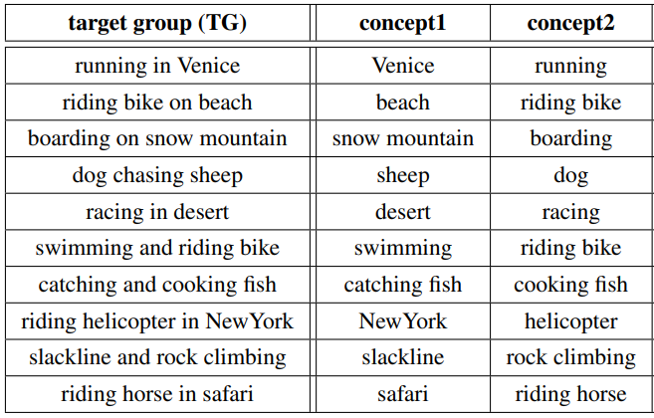
Dataset Grouping

Slide 5
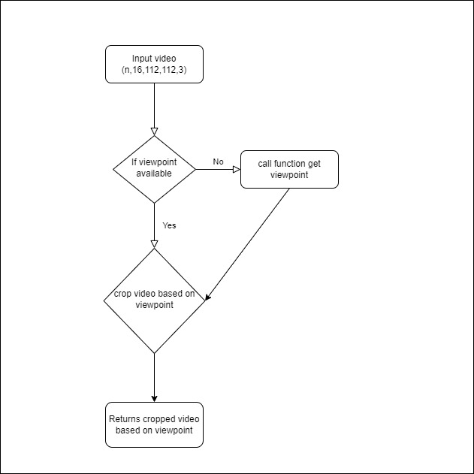
Flow chart to get the summarised
view point based video

Slide 6
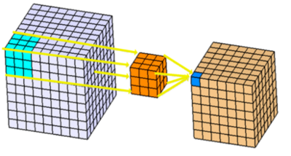
Algorithm
C3D (3D CNN)
3D convolutions applies a 3 dimensional filter to the dataset and the filter moves 3-direction (x, y, z) to calculate the low level feature representations. Their output shape is a 3 dimensional volume space such as cube or cuboid. They are helpful in event detection in videos, 3D medical images etc. They are not limited to 3d space but can also be applied to 2d space inputs such as images.

Slide 7
Model
Sports1M pre-trained model C3D
C3D is a modified version of BVLC caffe to support 3-Dimensional Convolutional Networks. C3D can be used to train, test, or fine-tune 3D ConvNets efficiently.
C3D Architecture
The network architecture contains 8 convolutional, 5 pooling layers and 2 fully connected layers.
The first convolution layer of size 1x3x3 followed by a pooling layer of size 1x2x2. This is to preserve the temporal information in the first layer and build higher level representation of the temporal information at subsequent layers of the network. Every other convolution layer and pooling layer would have a size of 3x3x3 and 2x2x2 where the strides are 1 and 2 respectively. The fully connected layers have a size of 4096 dimensions with SoftMax outputs reflecting 487 classes of the Sports 1M dataset.

Slide 8
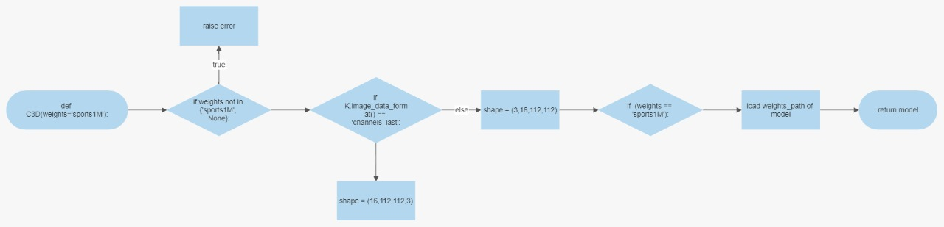
Loading the model

Slide 9
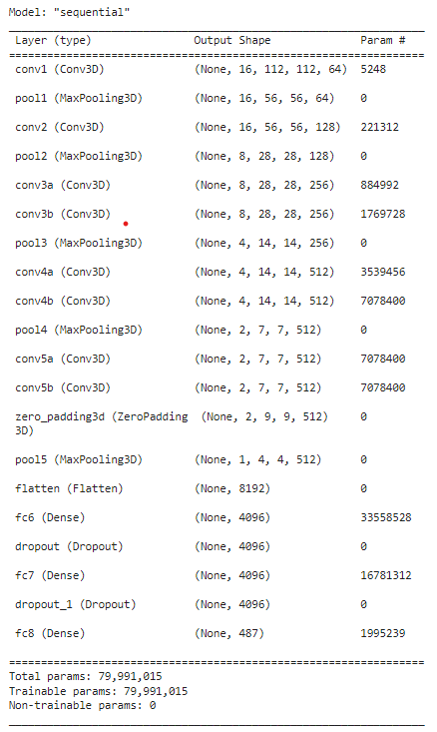
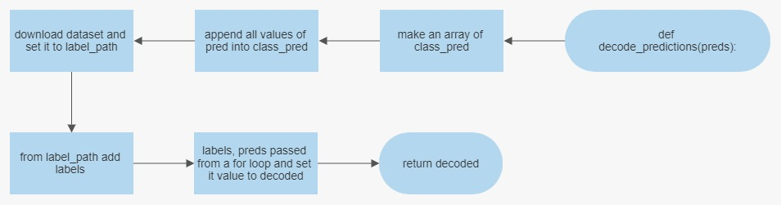
Input to Model
Model takes 16 frames of images as input dimension of 112x112 and 3 channels(RGB)
Output to Model
Model return a prediction index along with the confidence sore(0-1).
We later decode the prediction to get the object name. Fig below

Slide 10
Finding View Point
If view point is not explicitly mentioned we can consider the view point as the activity that is most frequent in all the given videos.
Steps to find view point
We will iterate through the video and in each iteration we will take 16 frames and pass it to the pre trained model to get the prediction.
If confidence score >0.05 we will add the predicted object to the dictionary (hash map) and if the object is already present we will increment its count.
Dictionary contains all the possible viewpoint sorted by the length.
The object having the maximum count can be considered as the viewpoint.

Slide 11
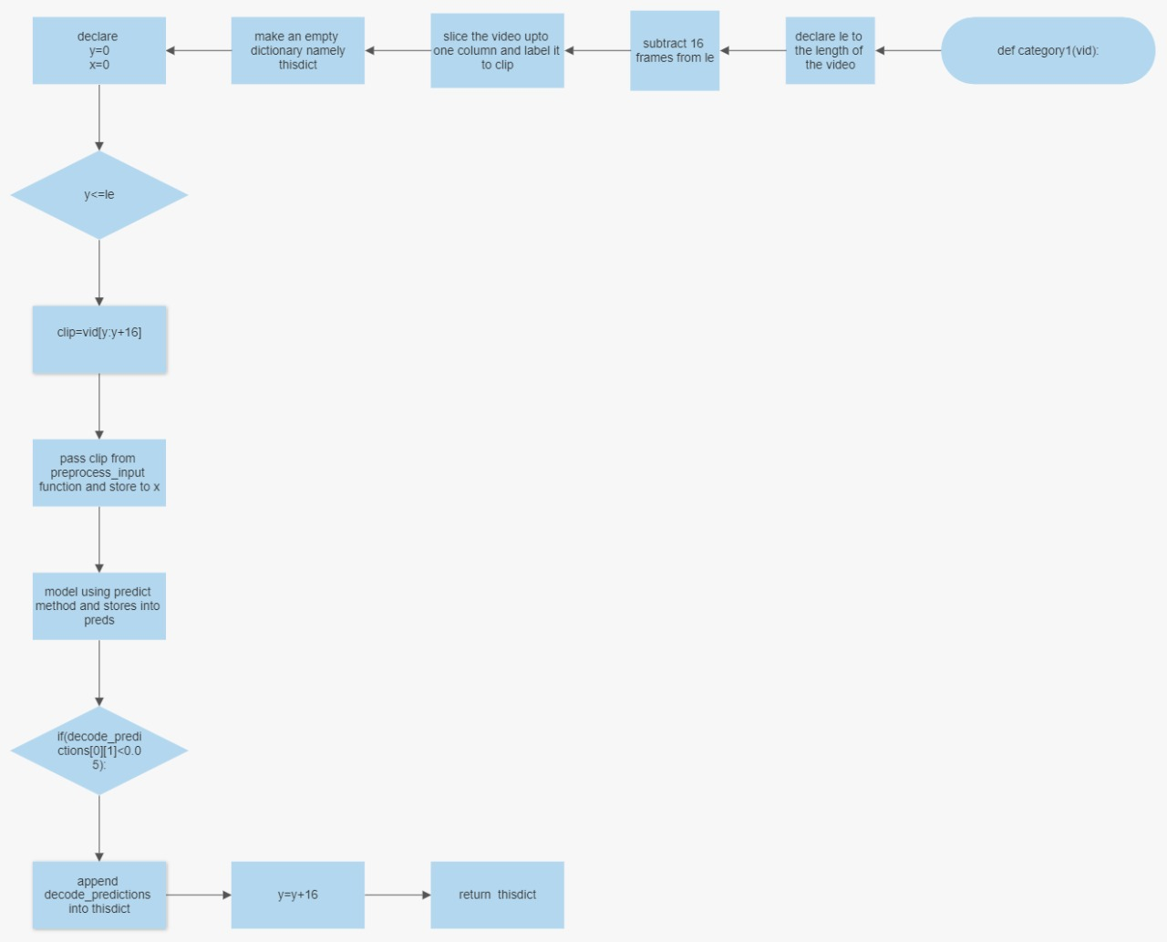

Slide 12
Cropping video based on viewpoint
Once we have viewpoint we can proceed to crop the video based on viewpoint.
We will again pass the video to the model but this time with a viewpoint.
Steps:
We will iterate through the video and crop 16 frames at a time and pass to the model.
If the predicted output is matched with the viewpoint we will add that clip of 16 frames to the final video.
We will keep account of the frame number in which the viewpoint is found in the a array which has the same size as the no . of frames in the video.
Array consist of “0” & “1” 1 denoting frame to consider for the final cropped video and 0 denoting frame not important.
Array name ot[]
Save the ot array for evaluation purpose.

Slide 13
Steps to the crop video
Steps:
We will first convert the entire video into frames and name the frames in ascending order i.e 1,2,3….n.
Now we will iterate through 0 to n (here iterator i)
If at ot[i]==1, we will add the frame in the output folder
Else will keep the frame in dump folder.
After the completion on loop we will have separated the important frame based on the view point in output folder.
Now we will combine all frame to produce the final video.

Slide 14
THANK YOU

